Slide 1

Title: Personal Expense Tracker Using Java
Student Name: Polisetty Sreeharsha
Student ID: 2520030123
Cluster: 2
Section: 5
Under the Guidance
of
Supervisor Name: Ms. Mamatha
Assistant Professor
Department of CSE

Slide 2
Abstract
• Personal Expense Tracker is a console-based application developed using Java and Data Structures. • It helps users record and manage their income and expenses. • The system allows users to add, view, search, sort, and undo transactions. • Data structures like Linked List, Stack, Queue, and HashMap are used. • The project demonstrates the practical application of data structures in financial management.

Slide 3
Existing System
Expenses are usually recorded manually in notebooks or spreadsheets.
Manual tracking can lead to errors and data loss.
Searching or organizing past transactions is difficult.
There is no proper structure to manage large amounts of data.

Slide 4
Proposed System
A Java-based console application for managing personal expenses.
Allows users to add income and expense transactions.
Provides features like viewing summary, searching, sorting, and undo operations.
Uses data structures such as Linked List, Stack, Queue, and HashMap for efficient data management.

Slide 5
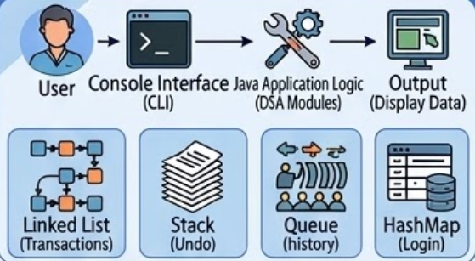
System Architecture
• User interacts with the system through a console interface. • The application processes user inputs and performs operations. • Data structures are used to store and manage transactions. • Linked List stores transaction records. • Stack manages undo operations. • Queue maintains transaction history. • HashMap stores user login information.

Slide 6
Project Modules
• User Authentication Module – Handles user login using HashMap. • Transaction Management Module – Adds and stores transactions using Linked List. • Summary Module – Calculates total income, expenses, and balance. • Search Module – Searches transactions using Linear Search. • Sorting Module – Sorts transactions using Bubble Sort. • Undo Module – Removes last transaction using Stack.

Slide 7
Objectives
• To develop a system for tracking personal income and expenses. • To apply data structures in solving real-world problems. • To implement operations such as searching, sorting, and undo functionality. • To provide a simple interface for managing financial records. • To improve understanding of data structures through practical implementation.

Slide 8
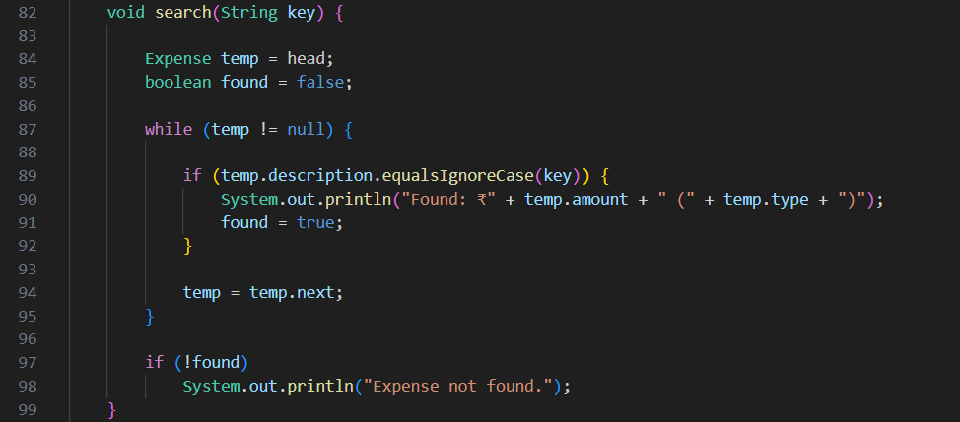
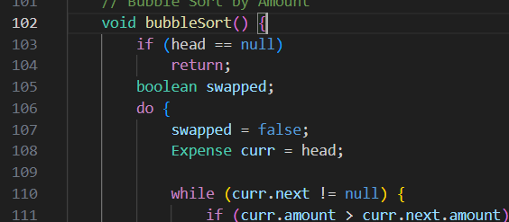
Co’s Attainments - DSA
CO1: Searching & Sorting
Linear Search
Iterates through the list using a while loop and equalsIgnoreCase to find a specific expense.
Bubble Sort Uses a do-while loop and nested while loop to compare adjacent curr.amount values and swap them if they are out of order.

Slide 9
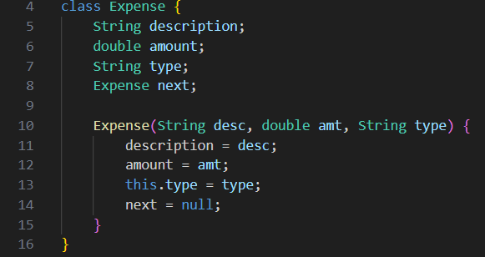
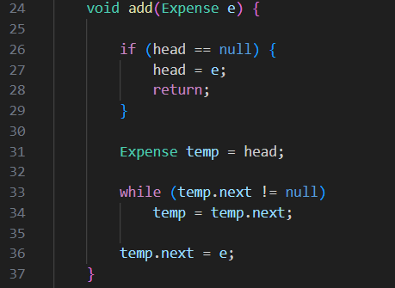
Co’s Attainments - DSA
CO2: Linked List Node Structure: Defines the Expense class as a self-referential structure containing data (description, amount) and a pointer (next).
List Operations: The add() method implements Insert at End logic. It traverses the list using a temp pointer until temp.next == null to link the new node.

Slide 10
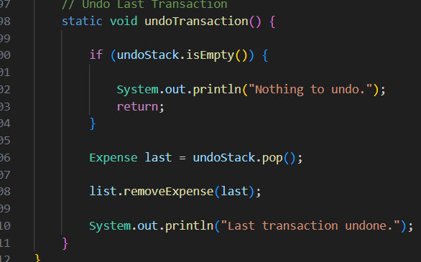

Co’s Attainments - DSA
CO3: Stacks & Queues Stack for Undo :Uses the LIFO (Last-In, First-Out) property. undoStack.pop() retrieves the most recent transaction to remove it from the main list.
Queue for History :Uses the FIFO (First-In, First-Out) property. Every new transaction is added to historyQueue to maintain a chronological log of entries.

Slide 11
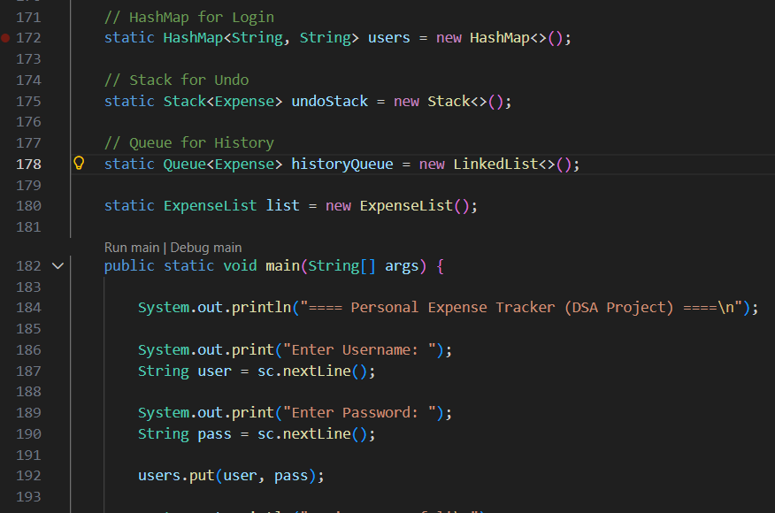
Co’s Attainments - DSA
CO4: Hash-based Structures & Collections HashMap for Login : A Hashmap provides O(1) average time complexity for searching. This is much more efficient than storing user in a list and searching through them one by one
Java Collections Demonstrates the use of built-in frameworks (Stack and Queue) to handle dynamic data efficiently without manual pointer management for those specific features.

Slide 12
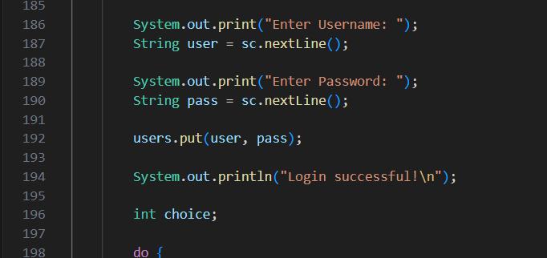
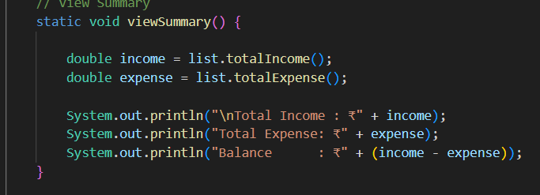
Co’s Attainments - DSA
CO5: Practical Application Expense Tracker :Integrates all the above structures into a functional CRUD (Create, Read, Update, Delete) application.
Financial Logic :The viewSummary() method processes the entire linear structure to calculate the current balance (Total Income - Total Expense).

Slide 13
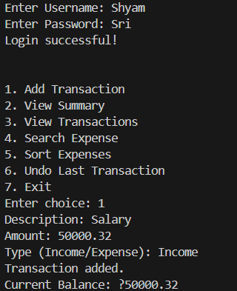
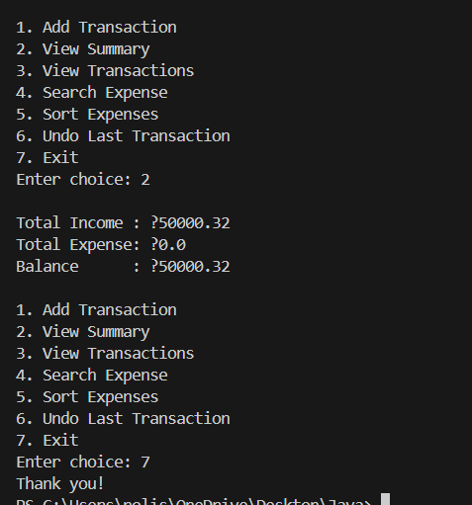
Screenshots for DSA

Slide 14
Conclusion
The Personal Expense Tracker successfully demonstrates how data structures can be used to manage financial data efficiently. The system allows users to add, view, search, sort, and undo transactions using structures like Linked List, Stack, Queue, and HashMap. This project helped in understanding the practical implementation of data structures and how they can be applied to solve real-life problems such as expense management.

Slide 15
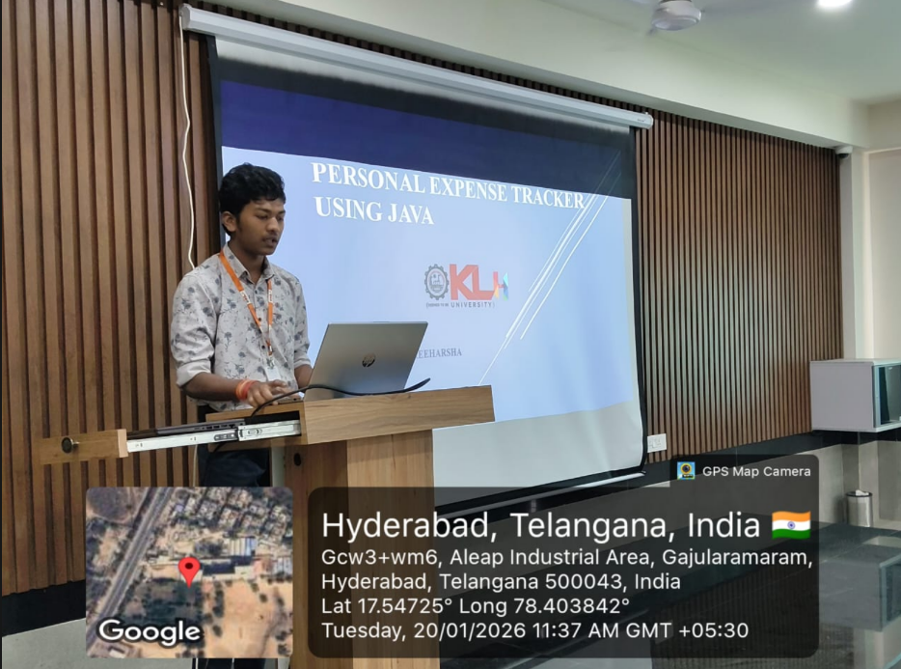
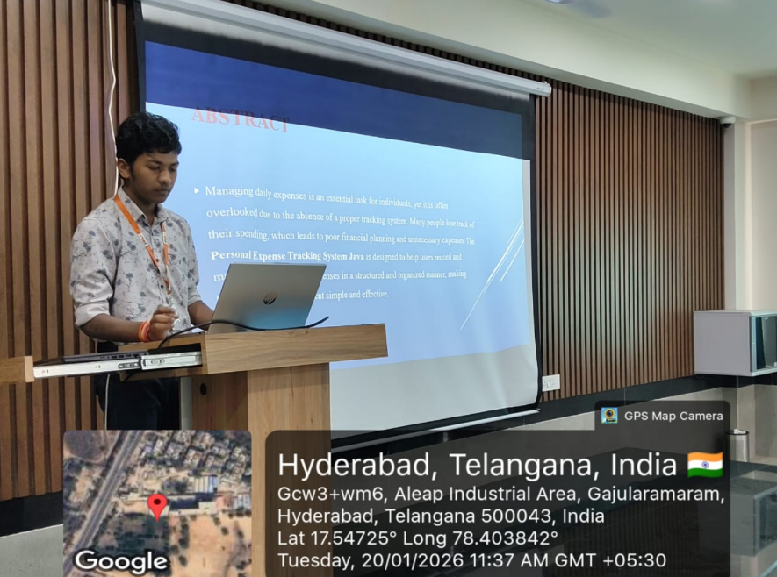
Geo- Tag Photos

Slide 16
THANK YOU

